Slide 1
Traffic Congestion and Incident Analysis
Pooja Nalan
Akansha Jain
Sai Deepika Gooty Agraharam

Slide 2

WHY THIS PROJECT?
Traffic Analytics
Commute Time
Impact on Economic Opportunities
Impact on Climatic Changes

Slide 3
PROJECT OBJECTIVE
To observe and analyze the pattern in traffic and any incidents that occur and also find the correlation between various traffic conditions based on speed of the vehicles, average speed of vehicles on a highway
Compare the incidents that occur on Saturdays vs Sundays
To generate Heatmaps for the congestion and incident analysis

Slide 4
PROJECT APPROACH
We chose I-205 highway data for May, 2019 which has heavy usage and is close to the real data
The I205 data has highway, station, detectors information
Using data from each of these stations gives a rough idea about the vehicles that pass through them at a particular point of time
We observed that speed is one of the major contributors to incidents (low or high).
Overspeeding and not keeping up with minimum speed are both equally dangerous on a highway

Slide 5
PROJECT APPROACH
We made use of average speed as an input to analyze and define congestion at different stations on the highway
Based on the calculation of congestion we plotted a heat map representing time and the station milestone
We also generated heat maps to plot the incidents that occurred. Finally, we analyzed the relation between incidents and speed

Slide 6

PROJECT MILESTONE
Traffic data collection and aggregation
Filtering the required fields and cleaning the data
Come up with a methodology to generate heat maps and plot incidents for the I-205 highway
Generate heatmaps and plot incidents on the I-205 highway.
Analyse the graphs and the important patterns/observations and the correlation between the average speed that lead to congestion and incidents.

Slide 7
CONGESTION ANALYSIS

Slide 8

CONGESTION DATA COLLECTION FROM PORTAL
Collected the I-205 highway data for each day in May 2019
Selected the North Bound (NB) and South Bound (SB) data for the same I-205 highway
Combined the NB and SB data
Downloaded the data for every 5 minute interval
We are concentrating on the congestion for all the days
Generate Heatmap for a given highway per day
PORTAL | Portland State University | Portland Oregon (pdx.edu)

Slide 9
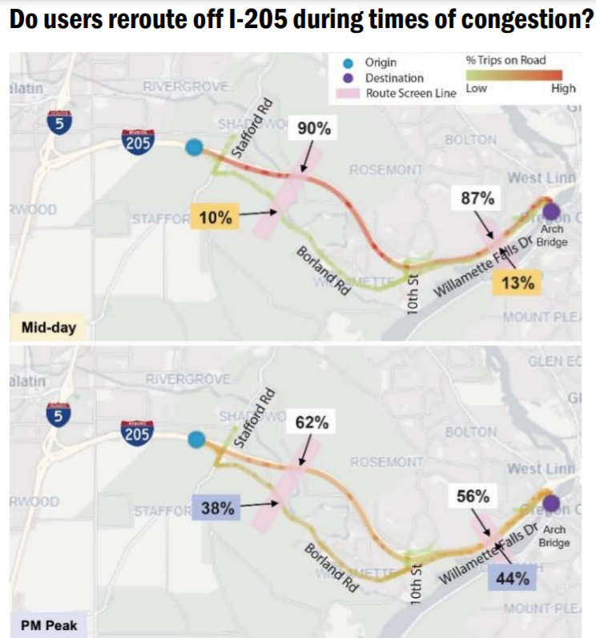
Earlier Studies
Existing Rerouting Patterns uses StreetLight to assess the likelihood of trips rerouting from I-205 due to current congestion levels.
Users reroute off of I-205 during higher demand periods when the traffic congestion is present.
During PM peak period, travellers choosing alternative routes increases to 35 - 45 % on order to avoid traffic congestion.
Where do trips using the I-205 Project segment come from and go to?
A relatively high share of Abernethy Bridge trips are local access trips from/to nearby areas such as West Linn, Oregon City, Gladstone and Clackamas.
About 10 to 15% of Abernethy Bridge trips have an origin or destination outside of the Portland metro region
Courtesy: I-205 Corridor User Analysis report 2019 using StreetLight Data, Inc. (StreetLight) mobility platform as the primary tool for the analysis

Slide 10
Rerouting Summary
Evidence shows rerouting off of I-205 and onto local streets during peak periods across a range of origin/destination travel patterns.
This rerouting takes place in both directions and is often due to heavier traffic congestion( delays ) on the I-205 in the southbound direction during the AM peak period and in the northbound direction during the PM peak period.
The magnitude of rerouting varied across different origin/destination pairs.
Local travel patterns showed a higher likelihood of rerouting than longer distance regional trips.
Borland Road, Willamette Falls Drive, OR 99E, Stafford Road and Schaeffer Road were identified as alternative routes that experience the greatest amount of rerouting.
The difference between percentage traffic share for I-205 versus an alternative route by time of day indicates the magnitude of rerouting, also known as the percentage shift of travel onto local roadways for trips between a given origin/destination pair.

Slide 11
This may reflect a greater willingness for local travelers to use local roadways as compared to longer-distance travelers who may be less comfortable with travel off of the I-205 mainline due to lack of familiarity or desire to avoid out of-direction travel
Rerouting patterns are often more prominent in the northbound direction and during the PM peak period.
Examining the travel pattern on I-205 north of OR 213 interchange heading southbound to the Oregon City area, most trips (79%) used the OR 99E interchange during the midday. However, a moderate shift of about 8% to travel via OR 213 and Washington Street was evident during the AM peak. This may reflect some travelers exiting I-205 one interchange earlier to avoid congestion on southbound I-205 during the AM peak period.

Slide 12
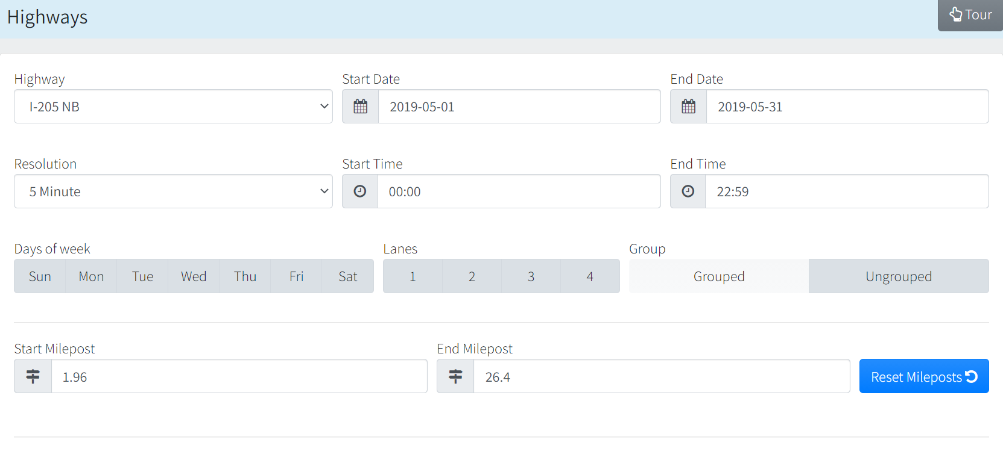
https://new.portal.its.pdx.edu:8080/downloads/

Slide 13
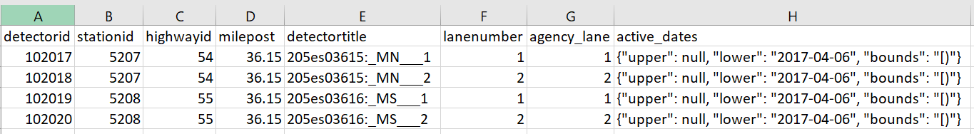
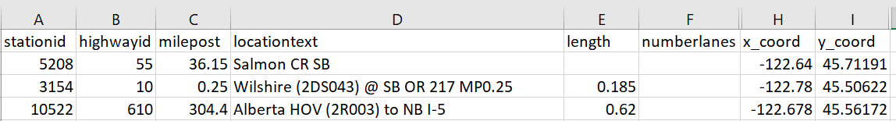
UNDERSTANDING THE DATA
DETECTOR METADATA
STATION METADATA

Slide 14
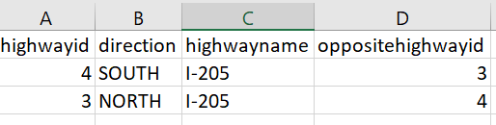
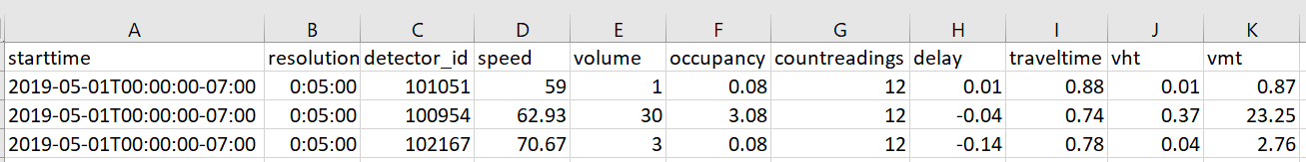
UNDERSTANDING THE DATA
HIGHWAY METADATA
SOUTHBOUND AND NORTHBOUND DATA

Slide 15
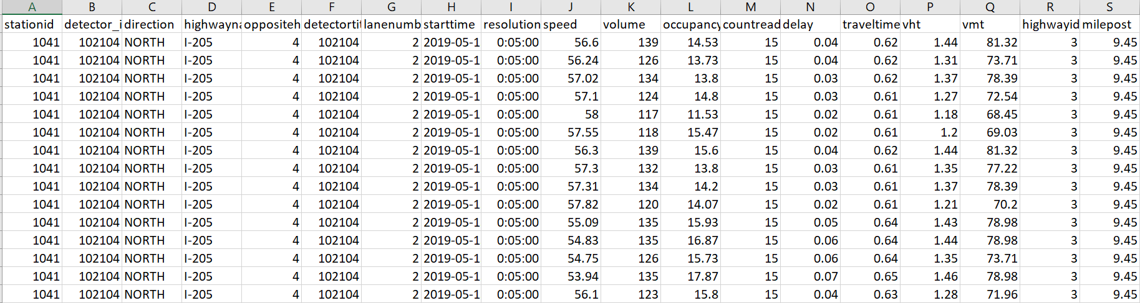
AGGREGATED DATA TABLE

Slide 16
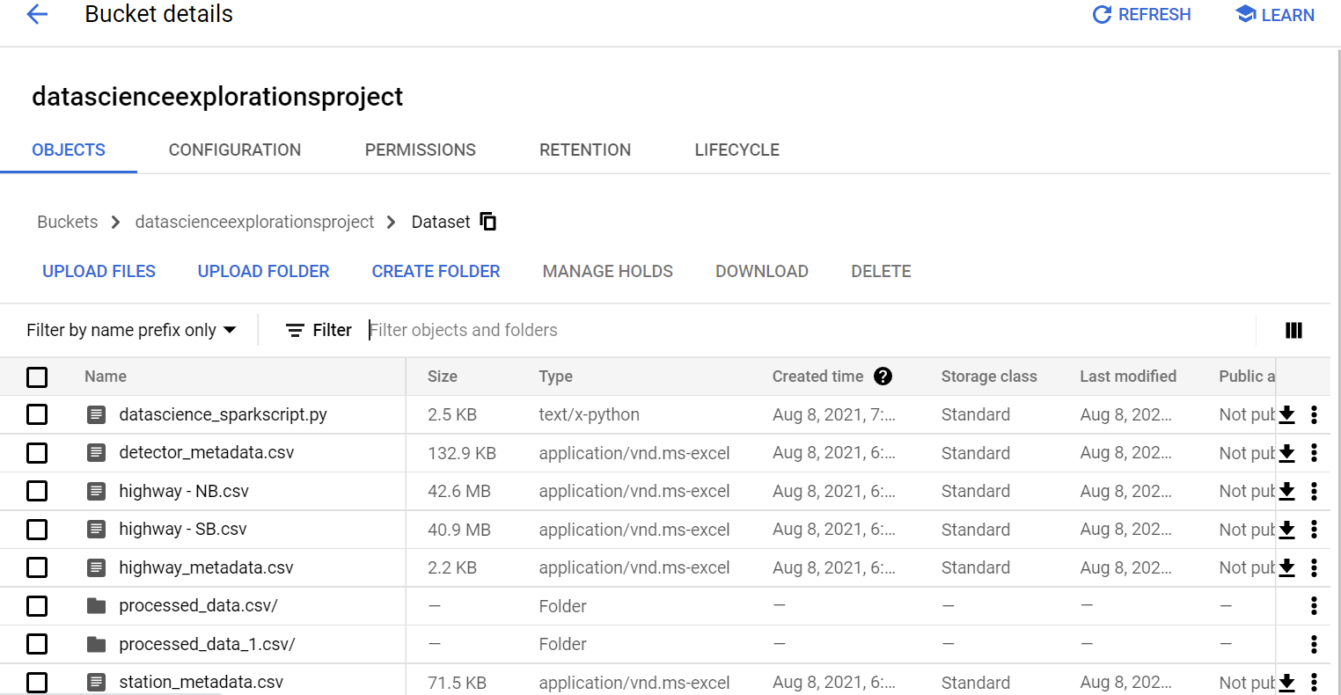
CLOUD STORAGE IN GOOGLE CLOUD PLATFORM

Slide 17
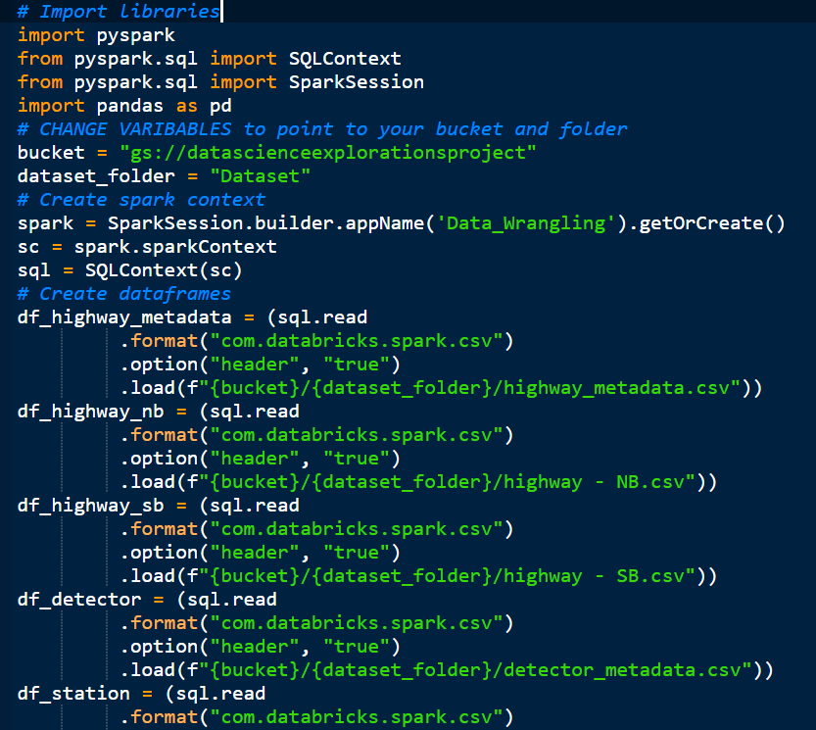
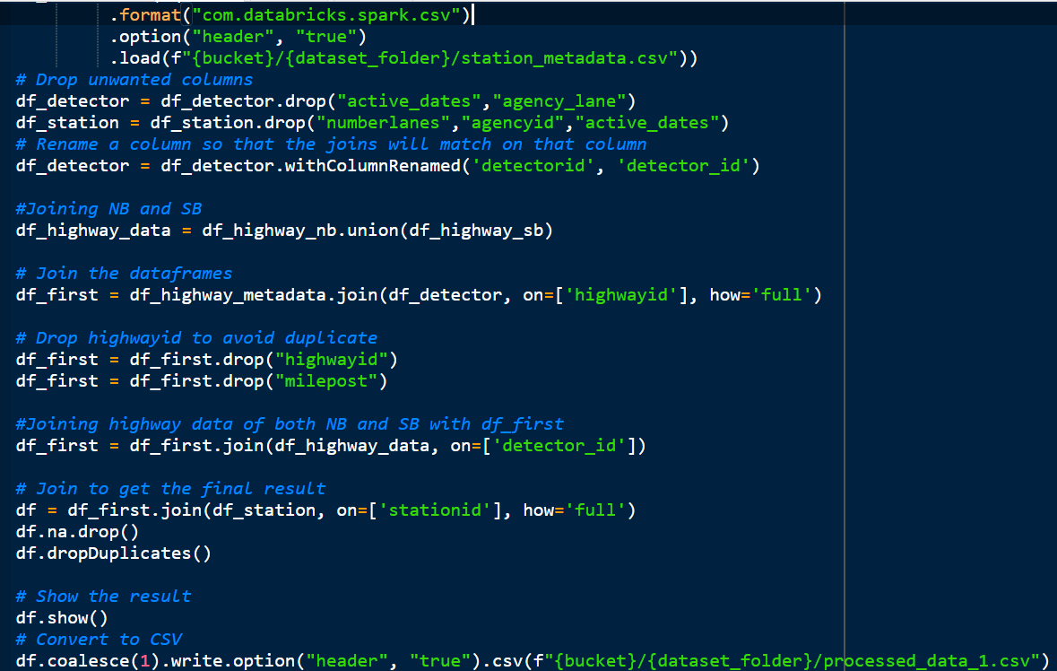
SCRIPT TO CLEAN THE DATA

Slide 18
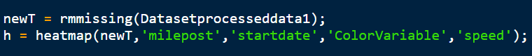
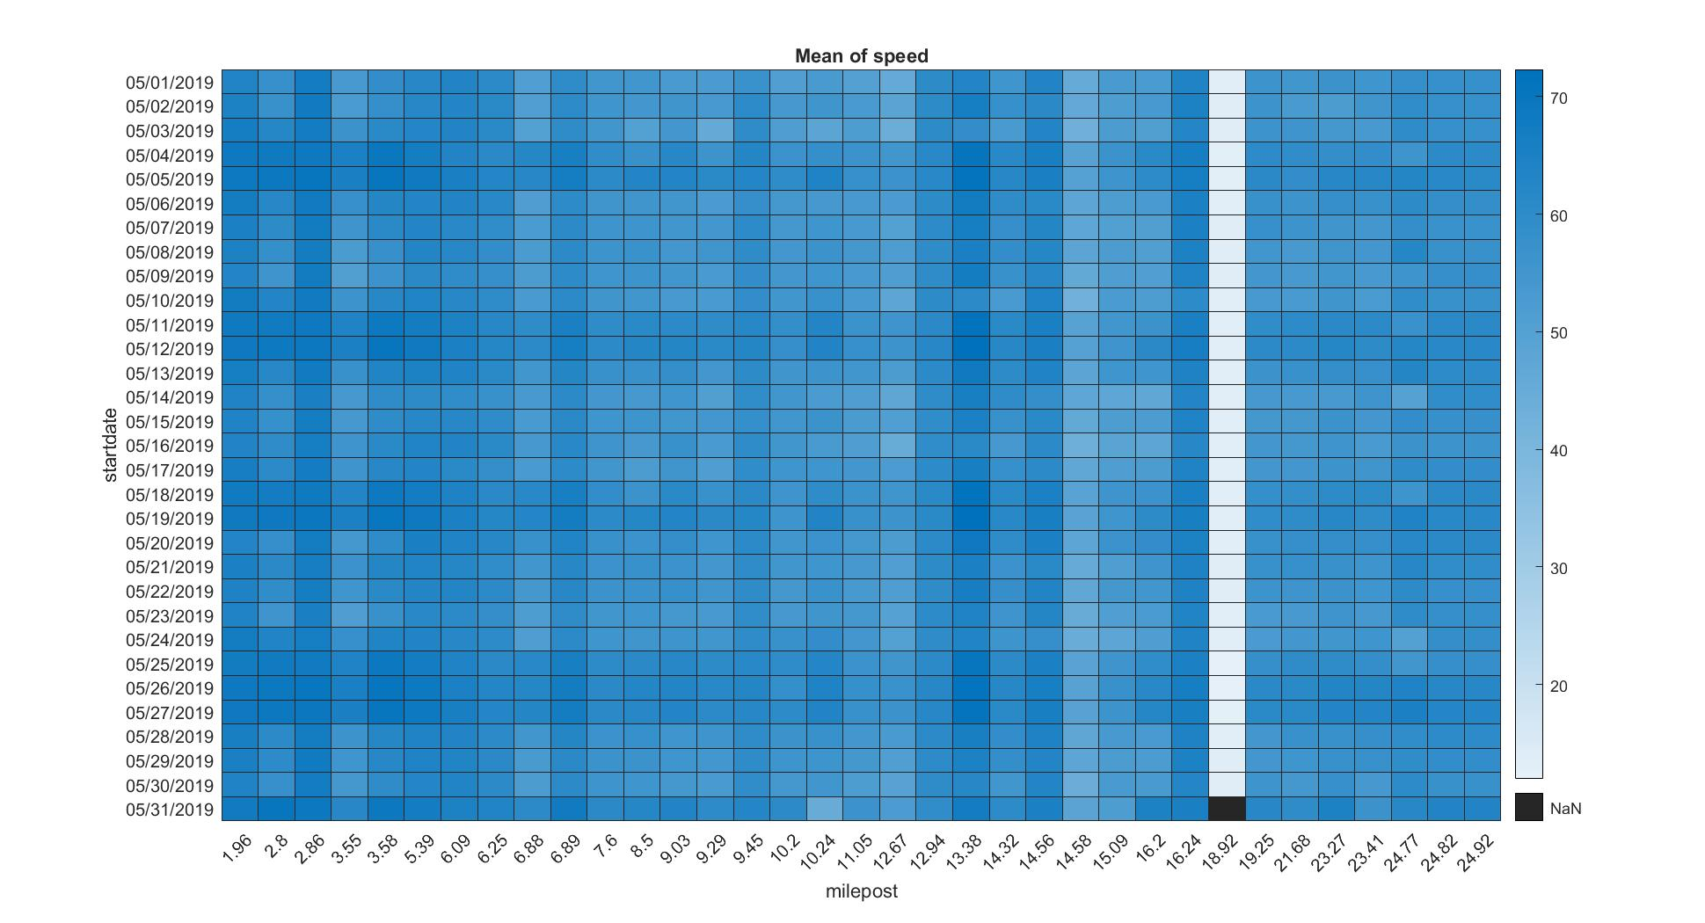
GENERATING HEATMAP - MATLAB
Plotting milepost vs startdate and average speed

Slide 19
CHALLENGES FACED WITH THE CONGESTION ANALYSIS
Limited data
Stuck to one highway and wanted to analyze the incidents and traffic for a period of one month at regular frequent intervals
Had to choose between:
Option 1 - Larger dataset with longer intervals
Option 2 - Smaller dataset with regular frequent intervals
Initially we loaded the data table to VM database copying it to postgres data table but then moved to using clusters to aggregate data.
Cleaning of data for all the files and then aggregate them was a big task
Analyzing how traffic conditions caused incidents

Slide 20
CONGESTION ANALYSIS CONCLUSION
SPEED
We observed that when the speed of the vehicle exceeded or was below the average speed there was more likely to be an incident
We assume there was likely a congestion when the speed was well below the average.

Slide 21
INCIDENT ANALYSIS

Slide 22

INCIDENT DATA
Collected the data of incidents for May, 2019
We analysed the data to compare incidents during weekends (Saturday vs Sunday)
We have counted the incidents for all weekdays and weekends

Slide 23
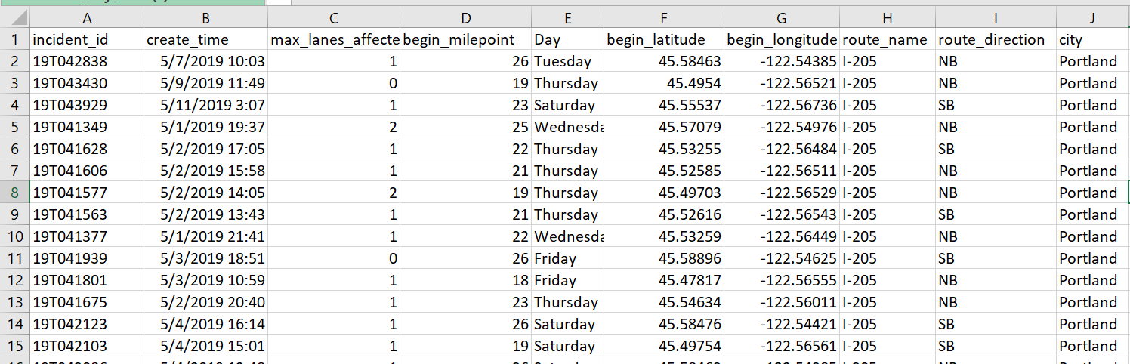
UNDERSTANDING THE INCIDENT DATA

Slide 24
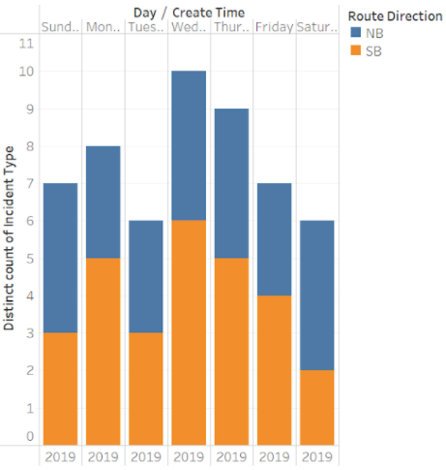
GENERATING HEAT MAPS - TABLEAU
1
DISTINCT COUNT OF INCIDENTS ON DIFFERENT DAYS

Slide 25
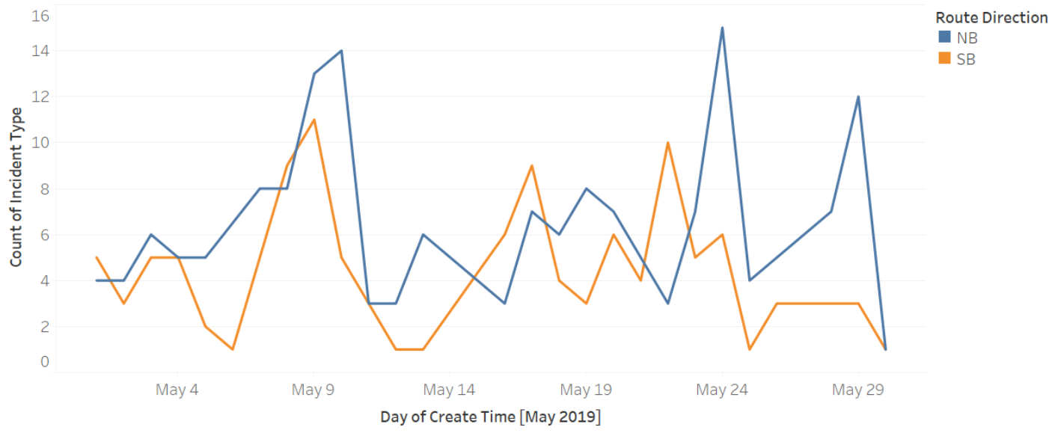
GENERATING HEAT MAPS - TABLEAU
2
INCIDENT COUNT DIRECTION

Slide 26
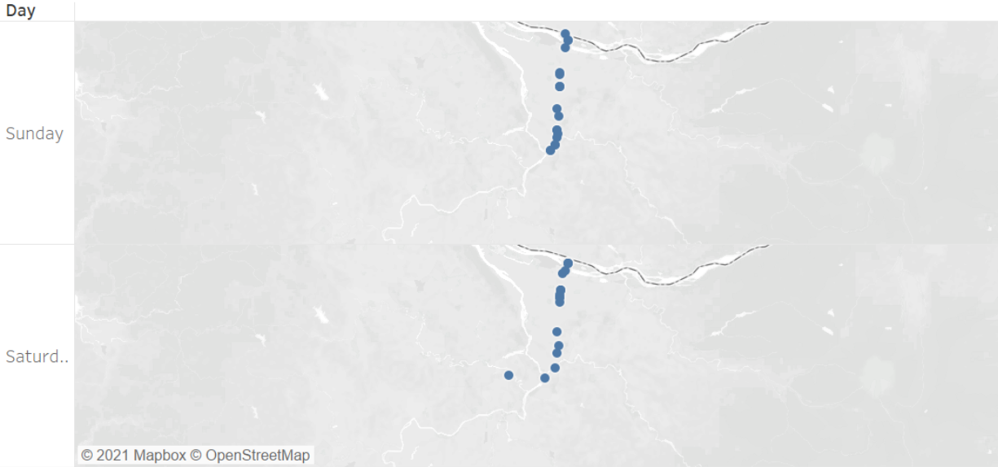
GENERATING HEAT MAPS - TABLEAU
3
I-205 NB SATURDAY vs SUNDAY

Slide 27
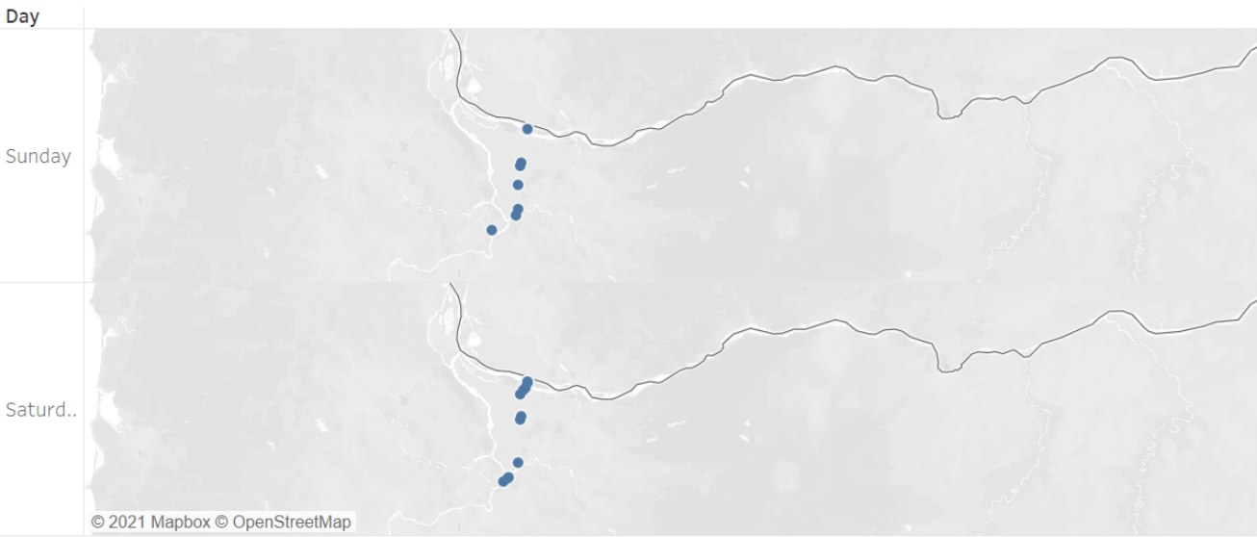
GENERATING HEAT MAPS - TABLEAU
4
I-205 SB SATURDAY vs SUNDAY
Description from the image

Slide 28
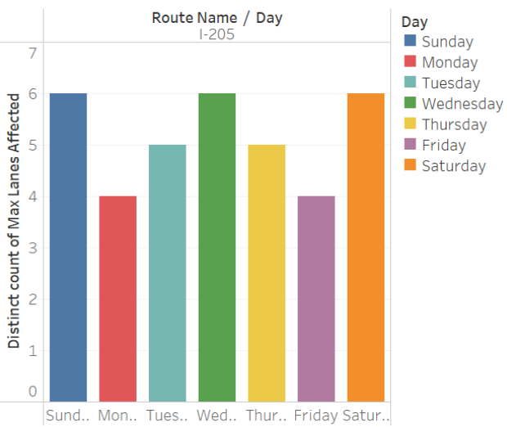
GENERATING HEAT MAPS - TABLEAU
5
MAXIMUM LANES AFFECTED

Slide 29
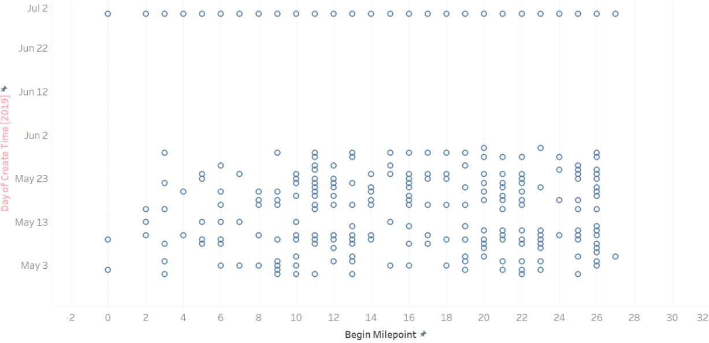
GENERATING HEAT MAPS - TABLEAU
6
INCIDENT MILEPOST

Slide 30


https://public.tableau.com/app/profile/akansha5101/viz/IncidentAnalysis_16287139850440/Story1#1

Slide 31
FUTURE SCOPE
Further analysis - Why the way it is and what can we do more
Congestion - Incident/Crash relations
In the Incident data Incident vs Crash
Weekend vs Weekday Traffic Analysis

Slide 32
Learnings
Take small data and do sanity check
Exposure to different stages of data science and new tools - Tableau and Matlab
Mob Programming

Slide 33


